Slide 1


An Introduction to
Cloud Foundry Security
Pivotal Field Engineering Team
Deck Authors:
Mark Fynes – tfynes@pivotal.io
Michael Palmer – mpalmer@pivotal.io
Darrel Sharpe – dsharpe@pivotal.io
Notes:
Resting slide on screen before you begin presenting.

Slide 2
Agenda
What is Pivotal Cloud Foundry?
Security Topics in the Cloud
CF Security: Automation, Abstraction, and De Facto Governance
How we think about:
Data Protection
Network Surface Area and AuthZ / AuthN
Patching & Upgrade Operations
Auditing & Logging
Other Topics

Slide 3


Background
What is Pivotal Cloud Foundry?
Notes:
At Pivotal, we believe Transforming how the world builds software will shape the future.
This is our core guiding principle that shapes our product and corporate strategy

Slide 4

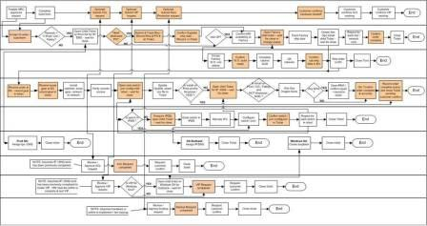
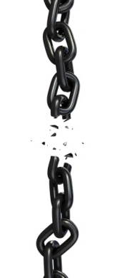

Bespoke Application Process Drives Complex, Manual Deploys & Waterfall Release Cycles
Developer
Operator
Notes:
We’re working with customers like Comcast and Lockheed Martin who have been struggling to ship software faster. Both in terms of new projects and implementing these modern, DevOps-friendly environments that can handle real continuous delivery.
If you’re doing big project with ‘agile waterfall’ where you use agile development with weekly sprints but have a huge manual process to actually ship every 3-9months.
Generally, IT organizations create bespoke processes, controls, automation around each application delivered (or, perhaps, each class of application). While this often affords security practitioners the opportunity to inject their opinionated view into the application via some form of process gating, their involvement revolves around a manual process: Manual invitation, and manual implementation of recommendations.

Slide 5

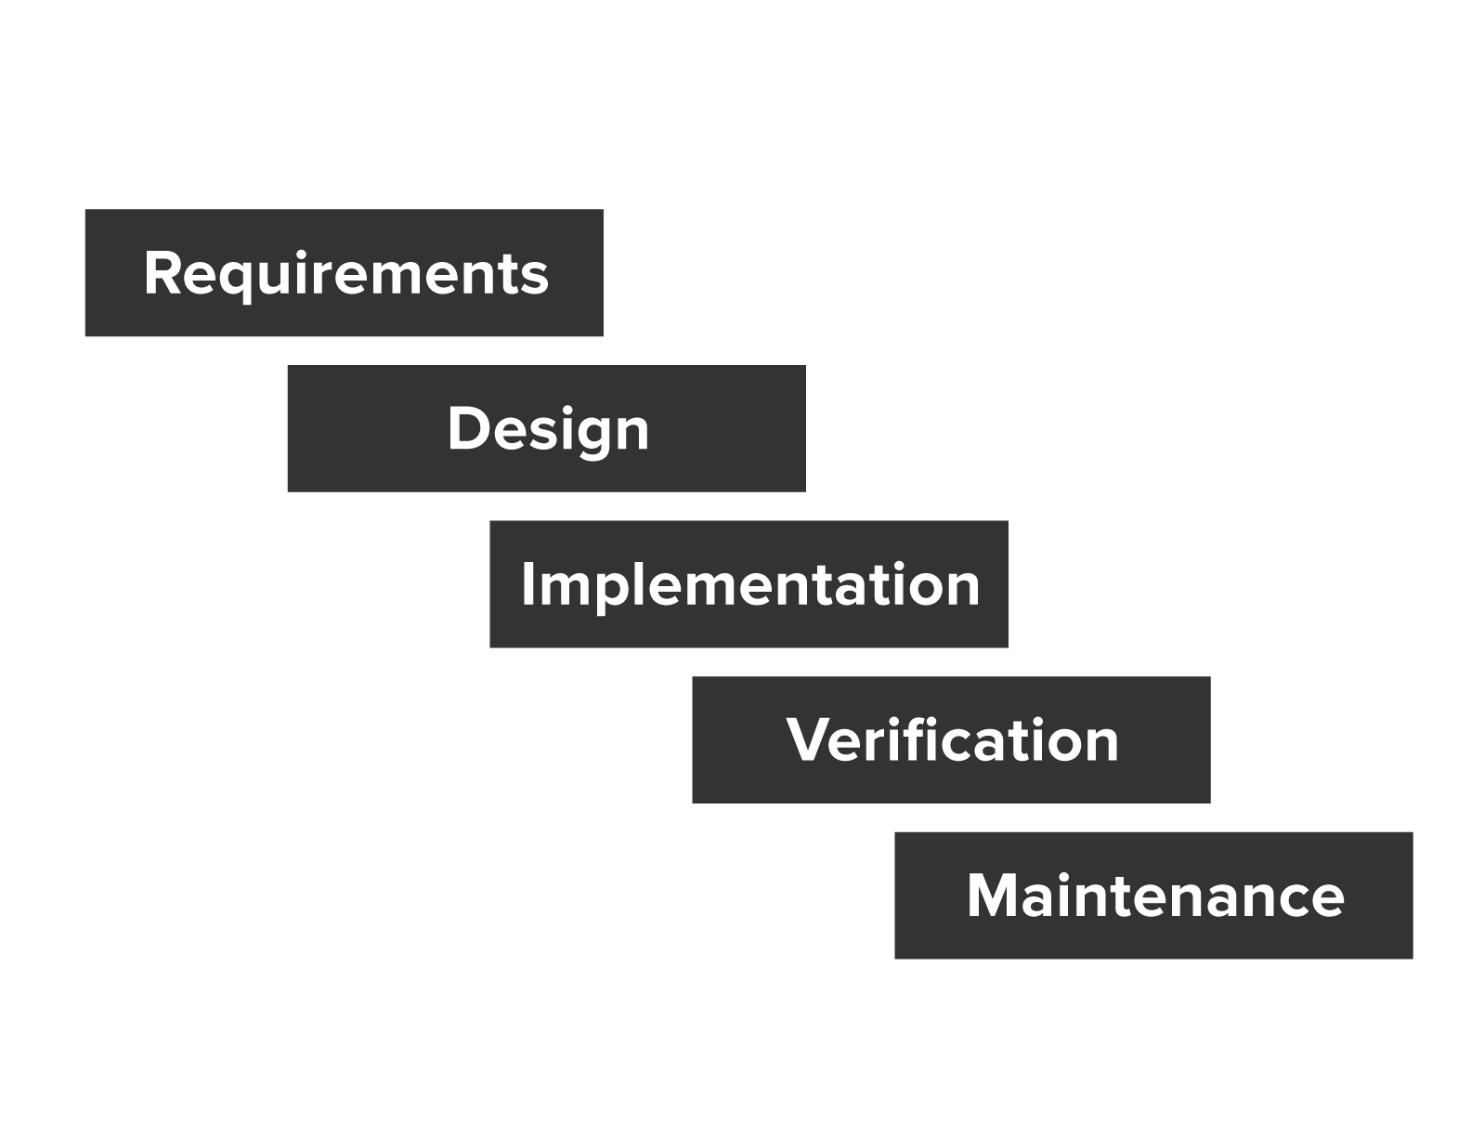
From idea to production: 6-9 months
Notes:
And if we look at how software is build and deployed today, for many enterprises, it still takes 6-9 months from an idea to deployment in production.
Many Dev and Ops teams foilow a version of the waterfall model with varying degrees of Agile/Scrum methodology applied to it. But that doesn't really change the fact that most of your developers are still waiting for the Release to train arrive. They can’t deploy to production whenever they want and are tied to release cycles that may happen as frequently as two weeks or as infrequently as every 3 mos.

Slide 6
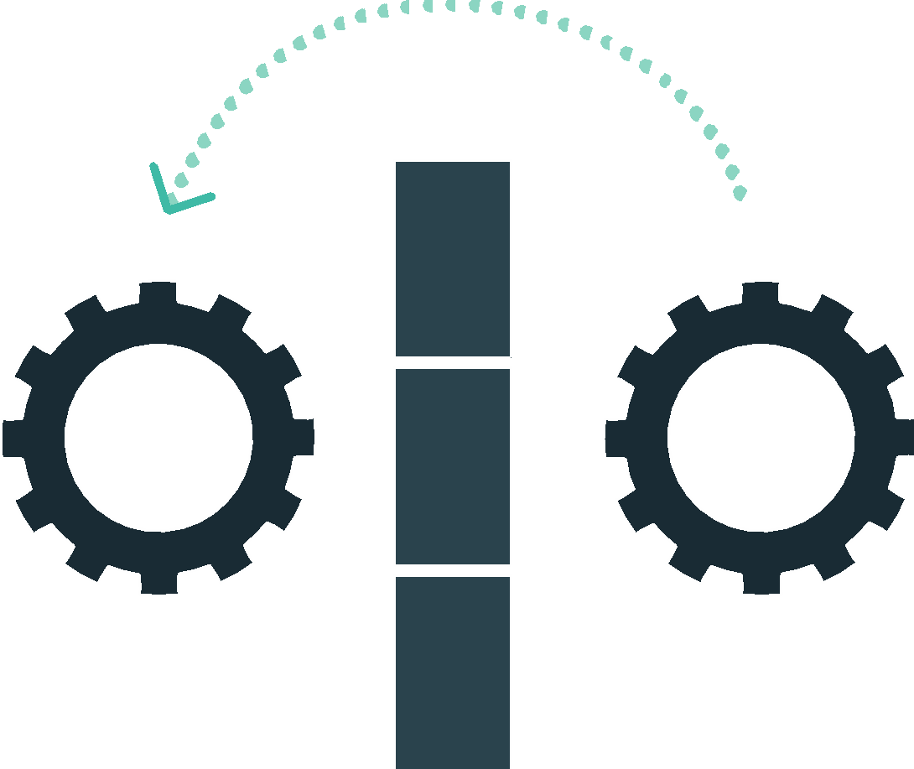
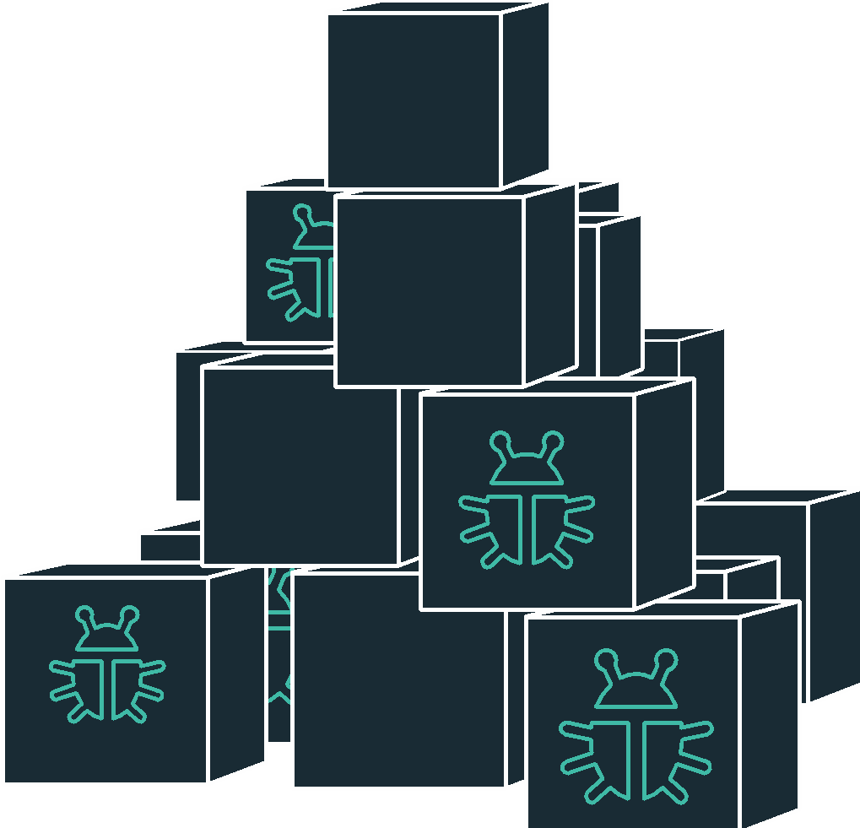

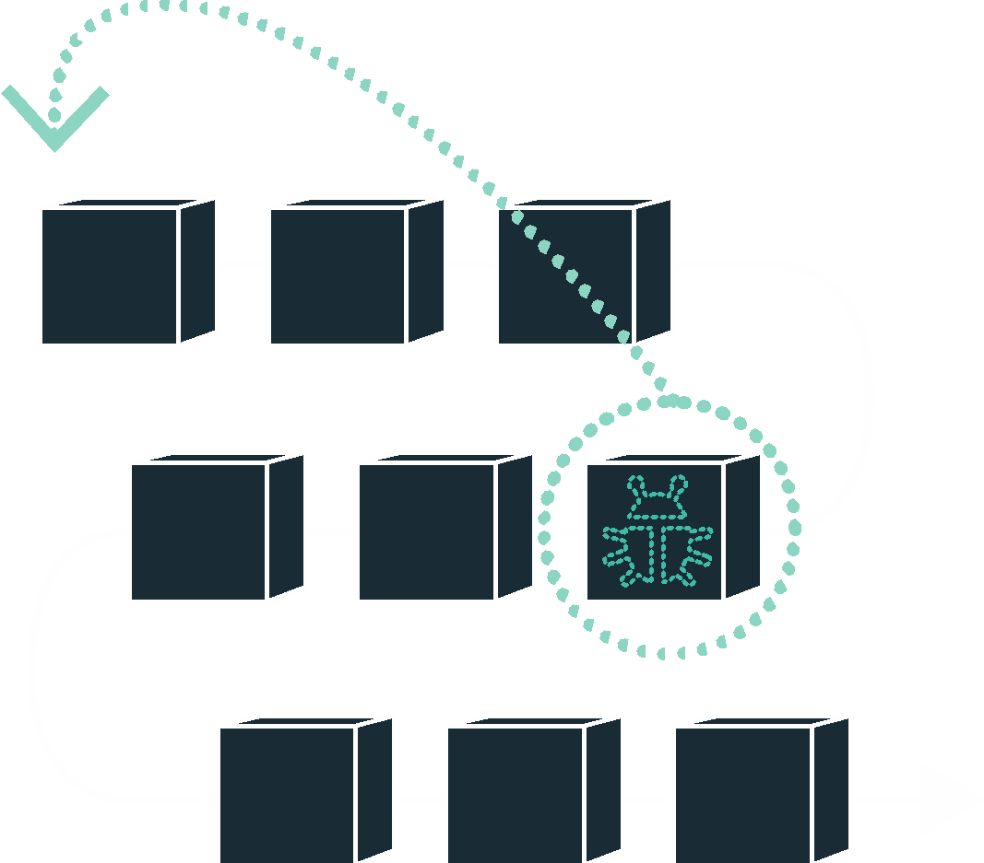
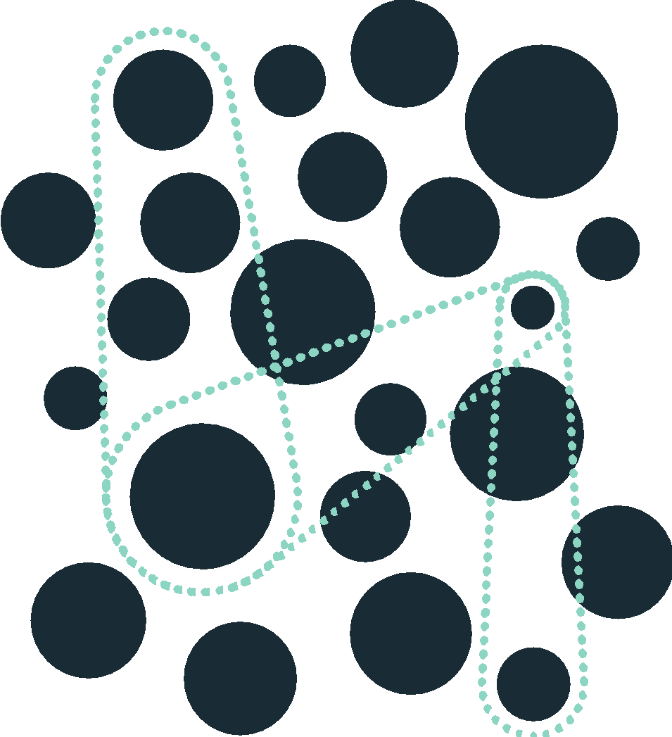
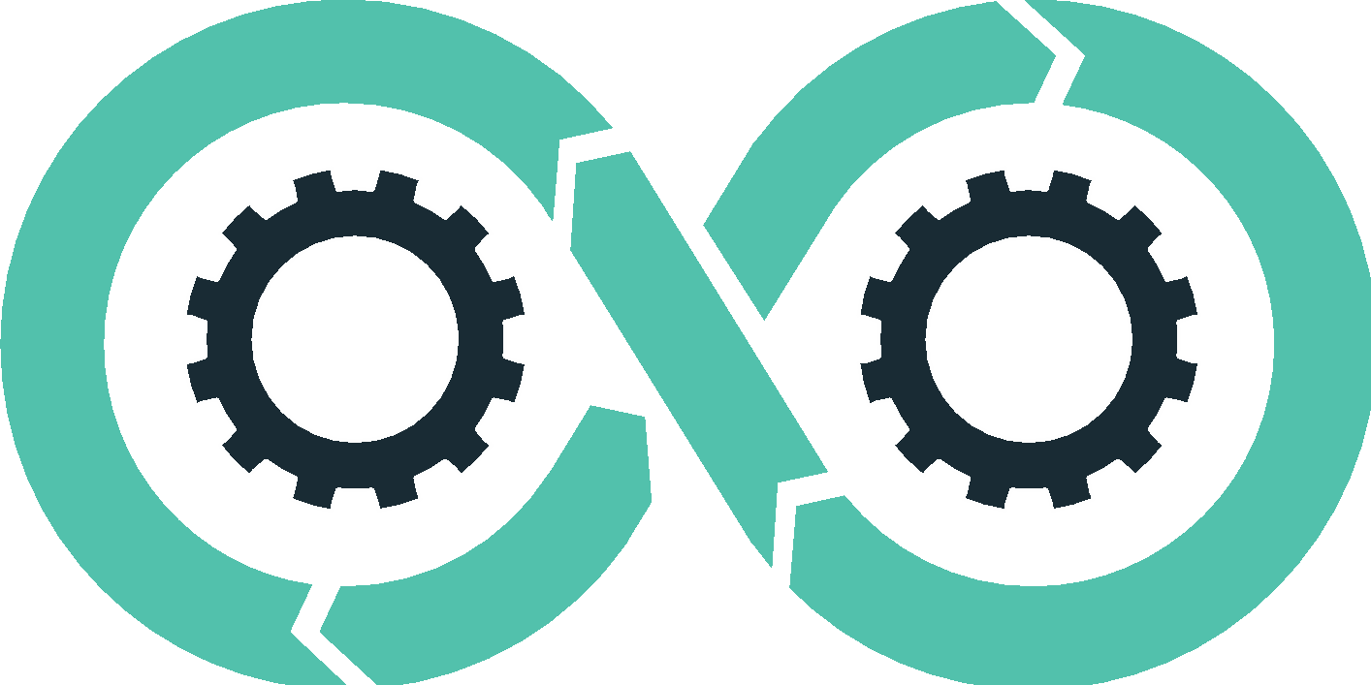
DevOps
Continuous Delivery
Microservices
Not my problem
Separate tools, varied incentives, opaque process
Release once every 6 months
More Bugs in production
Tightly coupled components
Slow deployment cycles waiting on integrated tests teams
Shared responsibility
Common incentives, tools, process and culture
Release early and often
Higher Quality of Code
Loosely coupled components
Automated deploy without waiting on individual components
Notes:
Speak to each, assume until verification that security practitioners are not completely knowledgeable in each.

Slide 7

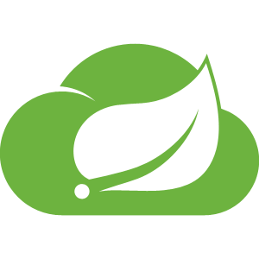
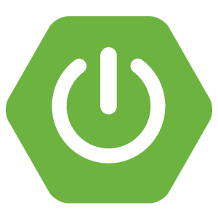

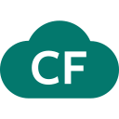
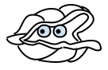
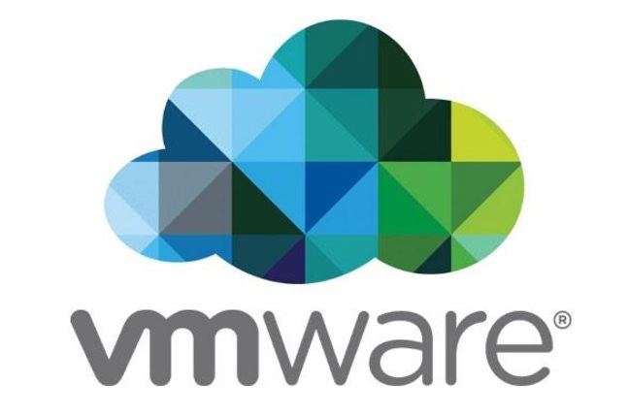
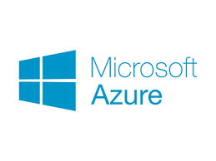

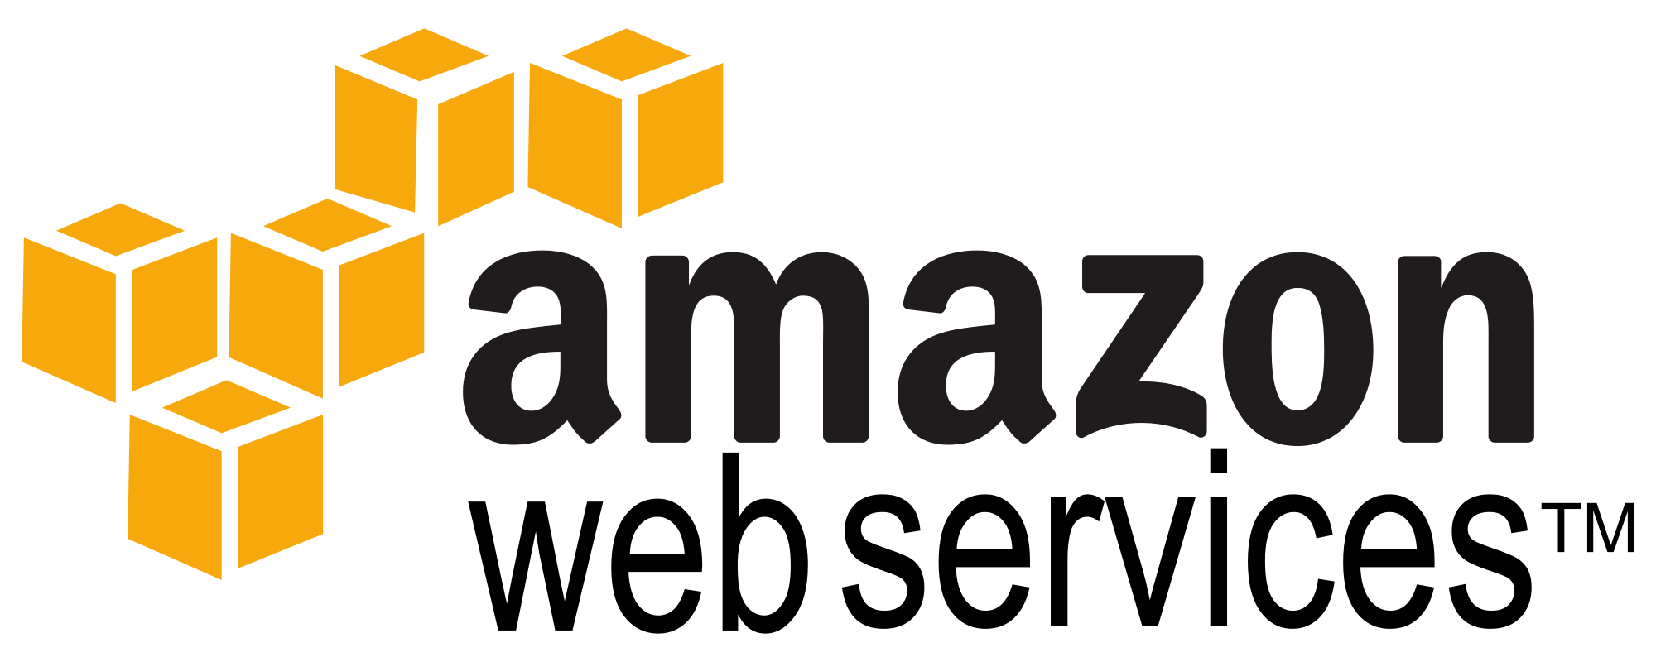
Culture
Cloud Native Framework
Tools
Application Framework
Spring Cloud
Spring Boot
Dev
Runtime Platform
Dev
IT Ops
Cloud Foundry
Infrastructure Automation
IT Ops
BOSH
Infrastructure
IT Ops
AWS
VMWare
Azure
OpenStack
Notes:
It’s important to understand the breadth and depth of Cloud Native technology -
Pivotal breaks down cloud native technology into 3 layers that are underpinned by your Infrastructure
From a CF POV, this means that we are thinking about security around PCF in 3 layers as well:
Applications: How are my apps going to leverage security? Like with context path protection (e.g., via Spring Security?) How will they authenticate and authorize?
Platform: How does the platform offer security services and the automation of policy and product implementation?
Infrastructure: How do we view encrypted links and volumes? How is this automated?

Slide 8
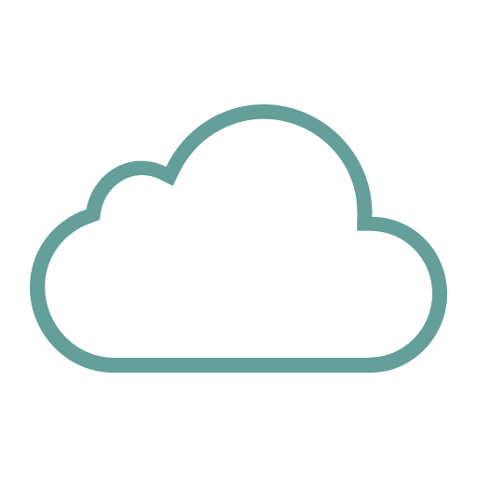
Platform Runtime
Services
Routing
Container Scheduling
Service Discovery
Configuration
Database
Application Framework
Big Data
12 Factor Apps
Microservices
RESTful Services
Circuit Breakers
Object Storage
Mobile
Spring Boot
Ruby on Rails
Node.js
.NET
Build CI
Logging & Metrics
Messaging
User Provided
Operations
Zero Downtime Deployments
Failover & Recovery
Scaling
Security Patching
Platform
Upgrades
Infrastructure
VMware
OpenStack
Amazon
Notes:
Let’s go into a little more detail about the components that actually make up Pivotal Cloud Foundry.
We the applications, which is where this starts. You need to select an application framework that lets you build these distributed systems.
We have a platform runtime, which handles routing etc. Attachable backing services for data, CI, and whatever your need
This is built on an operations layer
It does all this on Vmware and Openstack in your data center, plus Amazon public cloud. If each of those infrastructures was an electricity grid, Cloud Foundry would be the travel adapter. You get a single deployment API and set of backing services, so you can port applications with no code changes.
It comes down to this: Would you rather have developers spend their time building a platform, or using one?
Dev and Ops teams have to change together
Our customer base was struggling with partial transitions and continuous delivery

Slide 9
Security Topics in the Cloud
Automation, Abstraction, and De Facto Governance

Slide 10




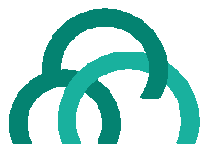
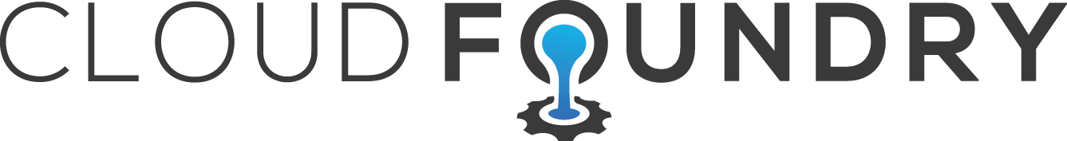
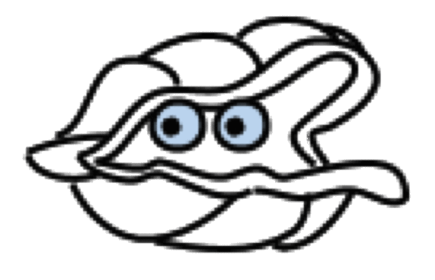
Application Framework
Language framework for microservice-based architectures including components for service discovery, metrics and circuit breakers.
Spring
Boot
Spring
Cloud
Dev
Contract: 12 Factor Application
Platform Runtime
Application container runtime with attachable backing services, automated CI/CD, routing, health management and logging.
Pivotal
Dev
Ops
Cloud Foundry
Contract: BOSH Release
Infrastructure Automation
A single deployment API for provisioning for bit-for-bit, consistent, self-healing deployments across any private or public cloud.
Pivotal
Ops
BOSH
Cloud Foundry
Notes:
Each layer of the application infrastructure is loosely coupled – the application runs in the platform as it follows the terms of 12 factor application manifesto (it’s not dependent on a specific OS, stores config in the environment rather than in code, etc). The platform runs on the infrastructure and infrastructure automation (i.e., BOSH on an IaaS) layer without predicating specific virtualization or cloud provider technologies.
This abstraction means that that applying security falls into the same categories, examples would include:
- App-specific security: How is authorization applied to application resources (e.g., via Spring Security)?
- Platform security: Define an SSO service that is backed by enterprise LDAP
- Infrastructure security: Encrypting virtual disks and network paths

Slide 11

Deploying App to Cloud Foundry Runtime
Blobstore
Service
credentials
Upload app bits and metadata
DB
push app
+ app MD
Cloud Controller
Service Broker Node(s)
Create and bind services
Stage application
Deploy application
Manage application health
Router
Cloud Controller Bridge
BBS
CELL
DEA
DEA
DEA
+
=
Auctioneer
Notes:
Security must be injected as a part of an automated process – not as a part of manual and individual application approval – if security is to be a key enabler of application delivery velocity.
<Briefly run through the process of buildpack-driven app deployment in the ER>
Here, as an example, we can leverage the automation in the buildpack ensures every application deployed is one with an approved patch level of JDK, Tomcat and implements an corporate internal security library. e can leverage this automation as a means to keep all of our deployed applications at an appropriate patch level <explain>
De Facto Governance means that, rather than asking personnel to do things the right (and possibly hard) way, we’re making the easy path the governed path: If you can accept the contract between the platform and application, then you can deploy your application with zero waiting, zero approvals.

Slide 12
Data Protection
Data-in-Motion, Data-at-Rest
Notes:
At Pivotal, we believe Transforming how the world builds software will shape the future.
This is our core guiding principle that shapes our product and corporate strategy

Slide 13












Elastic Runtime High Level Architecture
Pivotal CF Elastic Runtime
Dynamic Router
ROUTING
OAuth 2.0 Server (UAA)
Login Server
AUTHENTICATION
CC & CC Bridge
BBS
Converger
APP LIFECYCLE
BBS/etcd
MESSAGING
Service Brokers
CELL
Blob Store
APP STORAGE
& EXECUTION
Garden
Build Packs
Sys Log
Collector
App Log
METRICS & LOGGING
Pivotal CF OpsManager/BOSH
Notes:
First, it’s important to understand that the Cloud Foundry Elastic Runtime is, itself, a collection of microservices running on virtual machines. These services govern the health of your containerized applications, provide centralized logging aggregation, automatic scaling and load balancing, etc. Let’s take a look at an example of an inbound HTTP request to our sample application:

Slide 14
ER Ingress Networking Traffic Example
DMZ
Elastic Runtime Network
Services Network
Router
Cell
Cell
Cell
Container
Router
Container
Container
Load Balancer
Container
Outbound NAT
RabbitMQ
HTTP Client
Container
Container
Router
Container
Container
Container
Container
Router
Container
Container
Notes:
Talking points:
Walk through the multiple isolated networks referenced here https://docs.pivotal.io/pivotalcf/customizing/network-segmentation.html#multiple
Talk about your customer’s LB, and how it will need to reference the routers from the ER. The gporouters support ssl connections.
Talk about the routing tables, and the fact that the containers are on a different network than the Cell service / VM
It’s also a good time (if prompted) to talk about encryption between the router and the container. This is an IPSec story at the IaaS level
Security groups!

Slide 15
Container Isolation
Cell
Containers provide isolation of resources – CPU, memory, file system, process space, network
Containers have their own private network, not accessible from outside the Cell
App
App
App
App
Cell
App
App
App
App

Slide 16
Data-at-Rest
In the ER – two main points of non-ephemeral storage:
CCDB – Centralized storage for application metadata, includes access information for services leveraged by the application containers.
BLOB Store – Stores container images, application artifacts
Both can be externally managed and configured.
Notes:
Main point here is that you can accept the defaults (perhaps with disk encryption via IaaS), or use external MySQL DB / S3 storage that may more easily align with organization policy.

Slide 17
Network Surface Area
Getting Access via Network Endpoints, Controlling Access via AuthZ and AuthN
Notes:
At Pivotal, we believe Transforming how the world builds software will shape the future.
This is our core guiding principle that shapes our product and corporate strategy

Slide 18
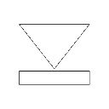

System Boundaries
service
dependent
HTTP/HTTPS
HTTP/HTTPS
Minimal Pivotal Cloud Foundry network access
allows PCF to be easily deployed on a VLAN or behind a firewall
reduces surface area for vulnerabilities
Ops Manager UI
HA Proxy LB
Service Broker
Ops Manager Director
Dynamic Router
Service Nodes
Operations Manager
Service
Cloud Controller
Health Manager
UAA
Login Server
Service Broker
DEA Pool
Service Nodes
Apps
Apps
Service
Messaging (NATS)
Metrics Collection
App Log Aggregator
Elastic Runtime

Slide 19
Container Isolation
Routers forward requests from outside using the app’s route to the assigned port on the Cell, which does network translation to the container’s internal IP and port
Apps are prevented from communicating directly with each other by container firewall rules; they must communicate through published routes
HA Proxy LB
Dynamic Router
Cell
Cell
App
App
App
App
App
App
App
App

Slide 20
End-User Identity
CLI
custom clients
Multitenant UAA/Login Server handles authentication
LDAP/AD integration
Identity Zones provides unique, isolated sub-domains
UAA is an OAuth2 token server
All interactions with the API must include a valid OAuth2 access token
HTTP/HTTPS
HA Proxy LB
HTTP
Dynamic Router
HTTP
Cloud Controller
UAA
Login Server

Slide 21
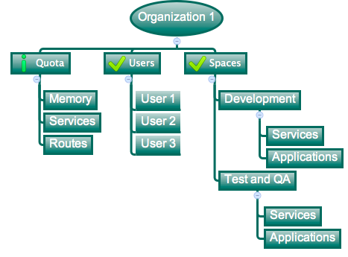
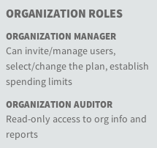
App Users: Orgs & Spaces
Logical divisions for tenants, having their own Quotas and Users
User permissions are specified per Org and Space
User administration is delegated to the Org level

Slide 22
Patching and Upgrading
Rapid, Zero Downtime and Highly Automated

Slide 23
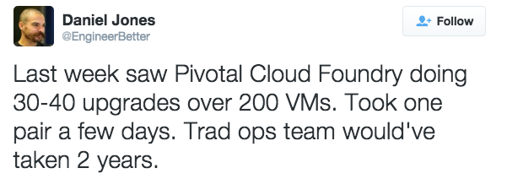
Patching CVEs Immediately
Notes:
One of the chief challenges to managing a distributed system is reacting to CVE advisories.
Patching CVEs at scale is hard – you have 100s or 1000s of VMs with different software. It’s hard to roll out patches in response to advisories at all, much less doing it automated, rapidly and with assurance that the outcome works. Let’s take a look at how PCF achieves this through automation and abstraction:

Slide 24
CF – Each Layer Upgradable with Zero Downtime
PCF Buildpack Apps
Application Team provided
Blue/Green deployments
application layer
Platform or Application Team Provided
CVEs addressed by Pivotal (for Platform Provided)
Blue/Green deployments
runtime layer*
Dev Supported
CF Supported
OS image
App container
Platform Provided
CVEs addressed by Pivotal
Canary-style, zero-downtime upgrades
linux host & kernel
* Devs may bring a custom buildpack

Slide 25
Infrastructure-centric Operations Model
‘VM’ level of abstraction inadequate
for efficient operations.
No App-Team autonomy as
manual effort or OpsCode needed
to manage deployments/updates.
Workload-specific VM & middleware
configuration result non-standardized,
‘snowflake’ deployments.
Your Application Code
App Team
(Dev and Ops)
Web Server
Messaging
Database
IaaS+ (+automation)
IT Ops Team
Virtualized Infrastructure

Slide 26
Application-centric Operations
New App-Platform Contract:
Application “Dial Tone”
Configuration
Runtime
Logs
Metrics
Health Management
Security
Operations
All provided by Platform
Your Application Code
App Team
Cloud Foundry
Platform Team
“App” level of abstraction allows
for App and Platform team
Operational Autonomy
Virtualized Infrastructure

Slide 27
Patching and Upgrading
Structured Platform Provides the Right level of Abstraction
Application Operations Autonomy
Platform Operations Autonomy
Notes:
Structured Platform Provides the Right level of Abstraction
Push the “App” (as opposed to customized VM)
Structured Middleware Provided by Platform Buildpacks
Platform generates and lifecycle-manages immutable containerized images in support of application workloads
Application Operations Autonomy
Freedom to self-service deploy/update without Platform Ops Involvement
Application Log streams and container-level SSH support allow for application troubleshooting without ever requiring direct platform VM access.
Platform Operations Autonomy
Zero-Downtime Application, Middleware, OS & Platform Update Support

Slide 28
Auditing and Logging
Inside of a Highly Distributed System
Notes:
At Pivotal, we believe Transforming how the world builds software will shape the future.
This is our core guiding principle that shapes our product and corporate strategy

Slide 29

Visibility Through Logs and Metrics
Single source for all platform logs and metrics. Single view console that makes system and application monitoring visible and actionable
First packet logging
Enables tool for external audit controls
Aggregated Logging
HTTP Events, Counters, Gauges, Errors
Every stdout and stderr from all apps and platform components
Health gauges
Snap-in best of breed application monitors
AppDynamics, New Relic, Splunk, etc.
Notes:
Application performance monitoring is built into the platform. Pivotal aggregates and streams all system logs, including the load balancer, application, middleware, and operating system. We also log and aggregate application deployment and scale events. You can combine Pivotal with Splunk or use a lower cost log event correlation system because we handle aggregation of multiple log sources. `When it comes to application metrics, we provide a multitude of IT operator data points, including routing counters and VM CPU/RAM health statistics. Each line of business can turn on auto-scaling that will increase/decrease the application instances when average CPU utilization goes up/down.
Lastly, Pivotal recognizes that some vendors can add monitor capabilities above/beyond what we provide. We strongly caution you against using “legacy” platforms like CA and HP, but App Dynamics and New Relic are PaaS aware and work out of the box with Pivotal CF.

Slide 30
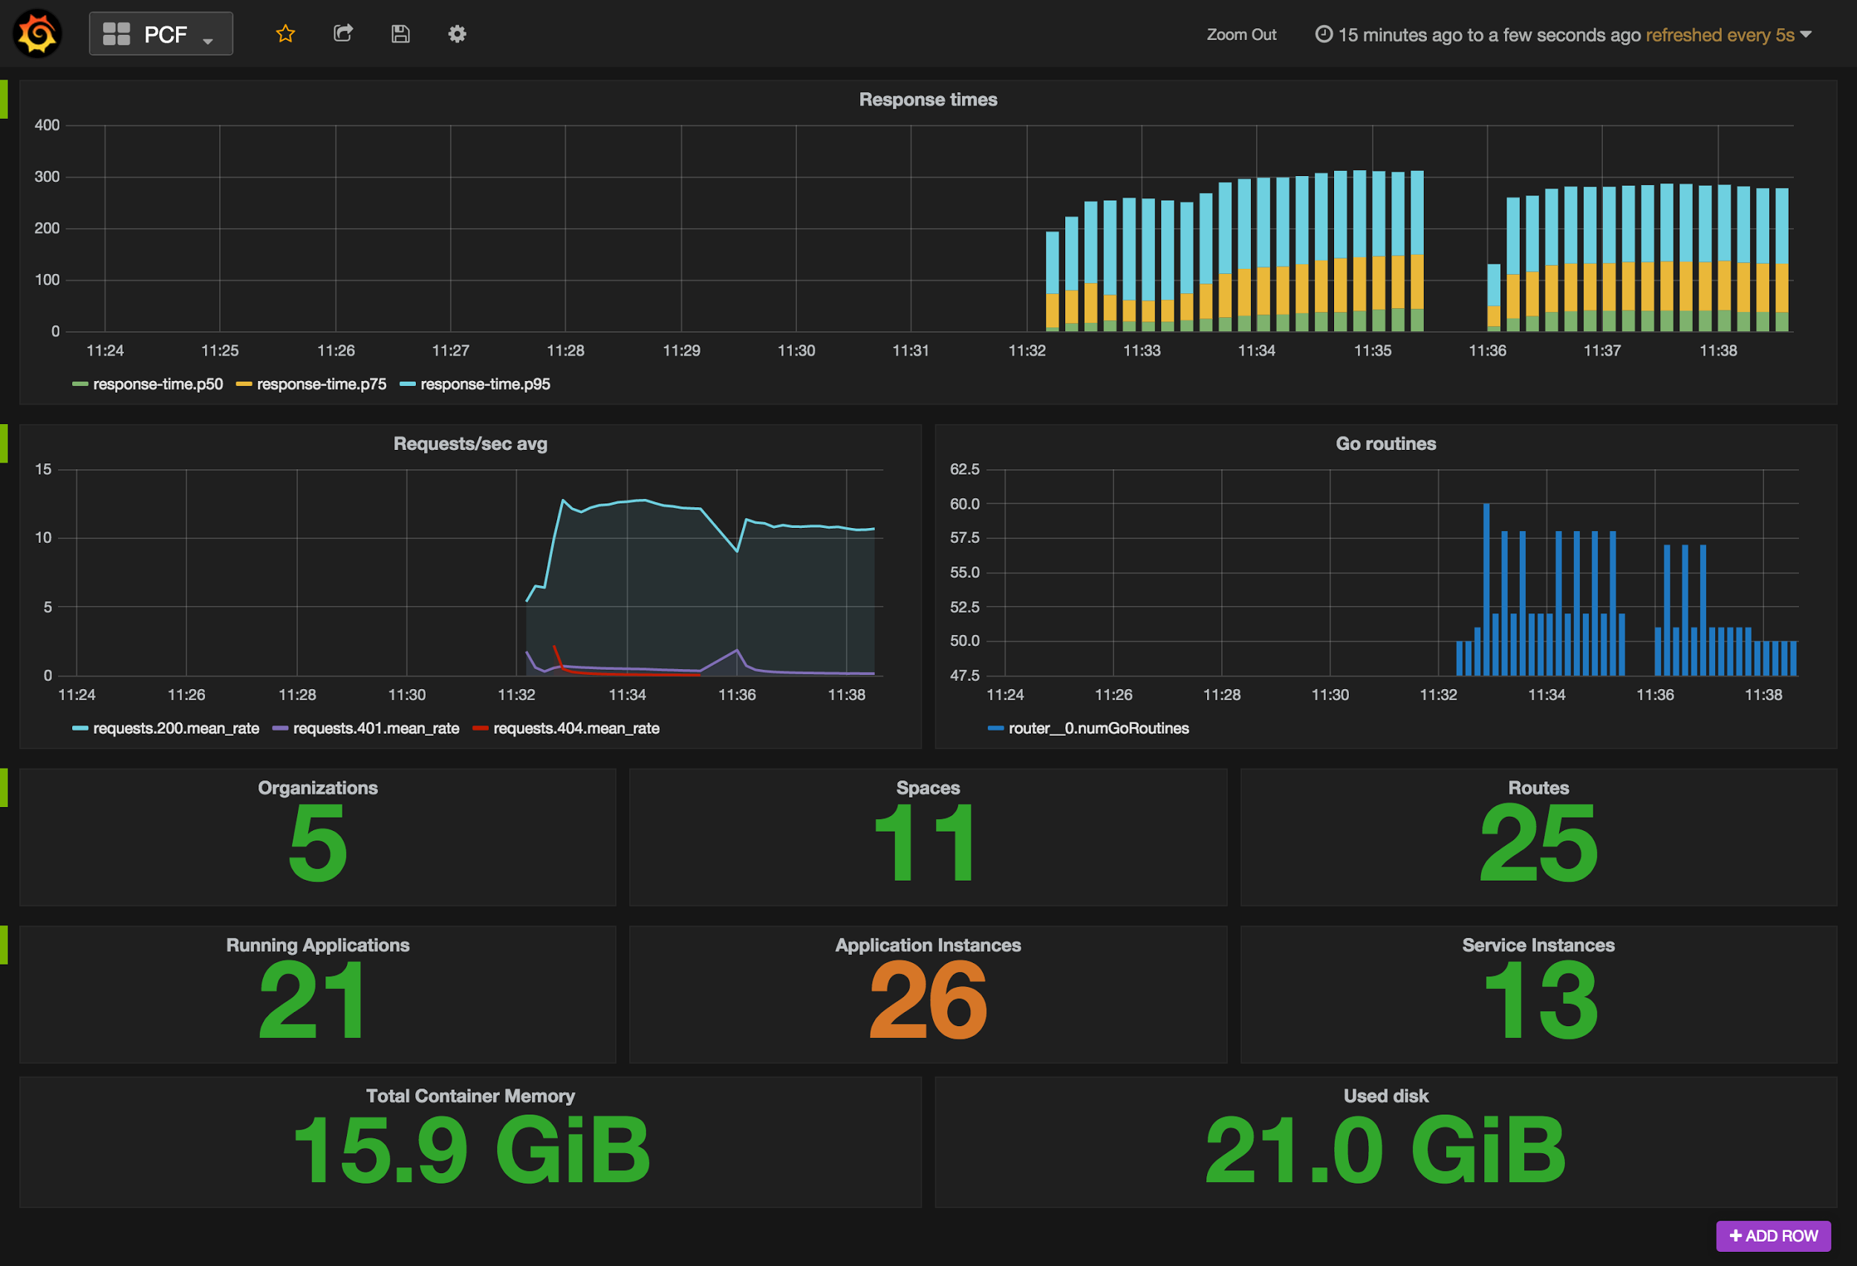
Platform Operations Logging
Platform Operations Logging Firehose
Overall Platform Health
Resource Utilization
Request Volumes / Latency

Slide 31
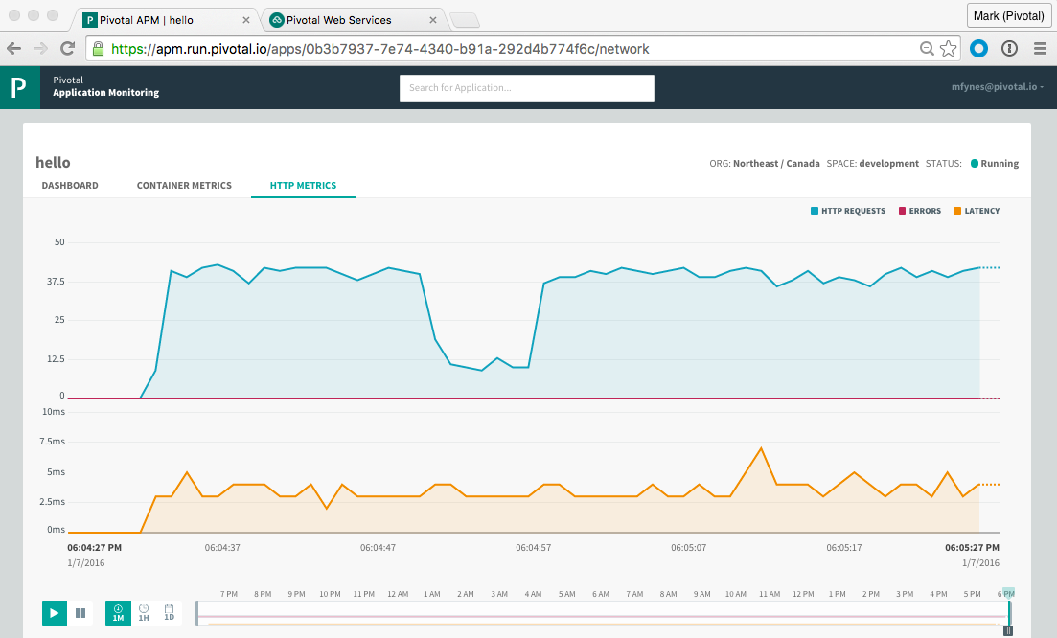
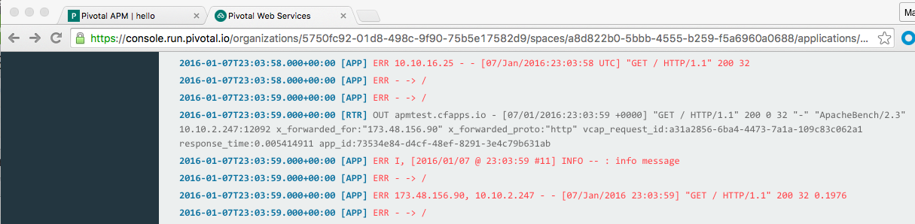
Application Operations Logging & Metrics
Self-service per-application APM dashboards
Per-application log-streams including relevant CF Router activity

Slide 32
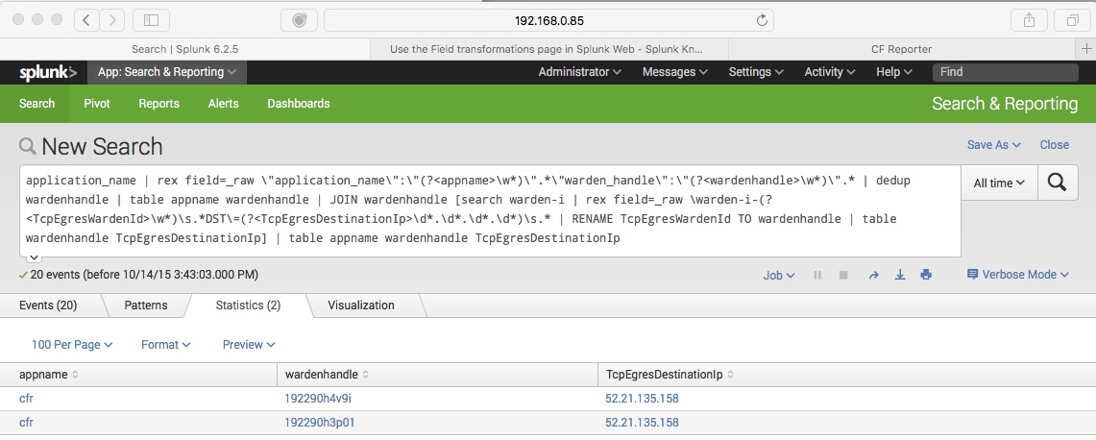
Forensic Logging
First Outbound Packet Logging
Allows for correlation of hosted applications and egress network activity
Rapidly isolate rogue applications making
illegal calls to downstream systems
10/14/15 4:43:58.025 PM <4>2015-10-14T16:43:58.025037+00:00 10.0.100.22 kernel [job=dea-partition-d10160260a487d942d73 index=1] [ 5162.416546] warden-i-192290h4v9i
IN=w-192290h4v9i-0 OUT=eth0 MAC=9e:0f:17:a4:e6:4b:72:31:2d:64:5c:64:08:00 SRC=10.254.0.34 DST=52.2.163.125 LEN=60 TOS=0x00 PREC=0x00 TTL=63 ID=52108 DF PROTO=TCP SPT=52292 DPT=443 WINDOW=29200 RES=0x00 SYN URGP=0

Slide 33

What did we leave out?
Software Distribution
Internal Auditing
Others?
Notes:
How does one become cloud native and what does it mean ? - lets dig deeper

Slide 34
Let’s build something MEANINGFUL
Notes:
From Silicon Valley…

Slide 35
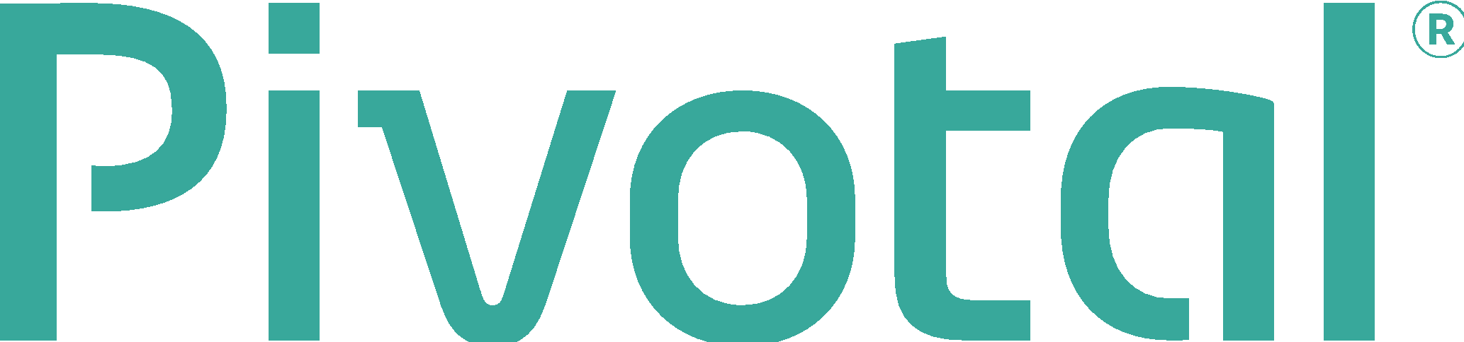
Q&A

